Slide 1



Tuesday
FEB.22
11 AM ET
BREAKING THE BURNOUT
CYCLE
AT WORK
ANDREW FREEDMAN
Managing Partner at SHIFT

Slide 2



The impediment to action is the action. What stands in our way, becomes the way.
Marcus Aurelius, Emperor of Roman Empire

Slide 3



What you’ll learn today
The reality about burnout
The role leaders and employees play in preventing, controlling, and reversing burnout
How to thrive amidst change and chaos

Slide 4

How is burnout affecting you and/or your team?

Slide 5
Burnout
An Occupational Phenomenon
​“A syndrome conceptualized as resulting from chronic workplace stress that has not been successfully managed.”
Not classified as a medical condition, and “refers specifically to phenomena in the occupational context and is characterized by feelings of energy depletion or exhaustion; increased mental distance from one’s job, or feelings of negativism or cynicism related to one's job; and reduced professional efficacy.
Source: The 11th revision of the World Health Organization’s International Classification of Diseases, ICD-11
Notes:
WHO (World Health Organization) in their 11th revision of their International Classification of Diseases, deemed Burnout as an occupational phenomenon – something caused in, and by the workplace, and, as we look at the definition, I want you to see that this syndrome is caused by organizational systems – things that leaders can most definitely influence.

Slide 6
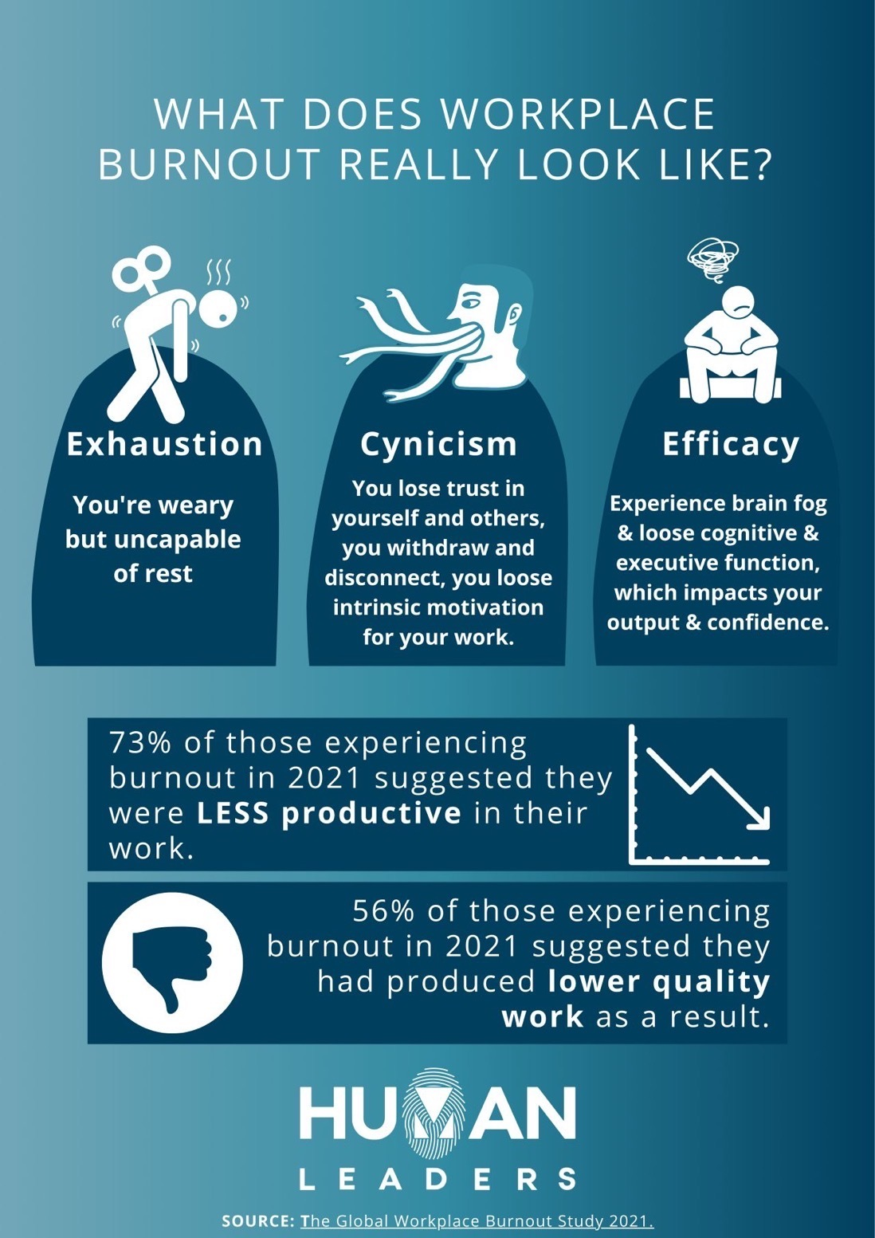

Slide 7
89% of professionals say they are suffering from burnout, with 38% saying they are burned out to a great extent
81% say they are more burned out now than they were at the start of the pandemic
When asked to describe how they currently feel when they think about work
66% of respondents say there is now more emphasis on employee wellbeing than pre-pandemic
70% say they are anxious and stressed
(vs 27% pre-pandemic)
45% saying there is now a greater emphasis on leader wellbeing
11% say they are content or energized
(vs 63% pre-pandemic)
Source: (Korn Ferry - 9/30/21) Burnout Blues: Korn Ferry Survey Shows Professionals’ Stress Levels Skyrocketing (survey of 672 professionals)

Slide 8
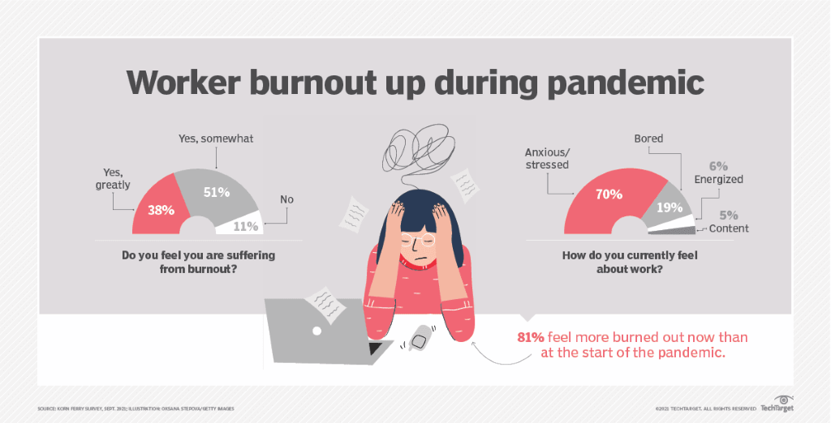

Slide 9
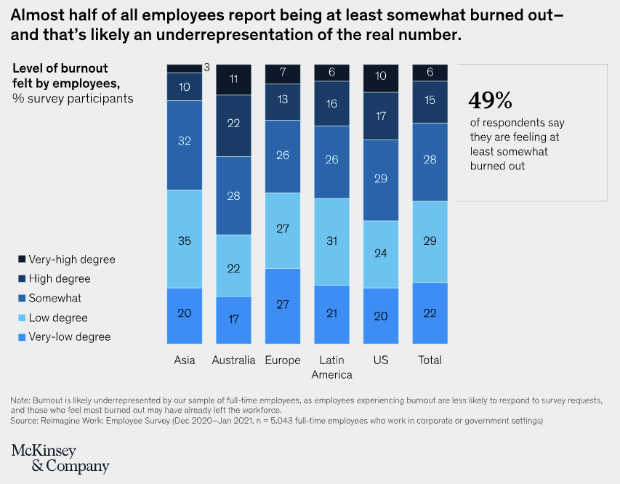

Slide 10
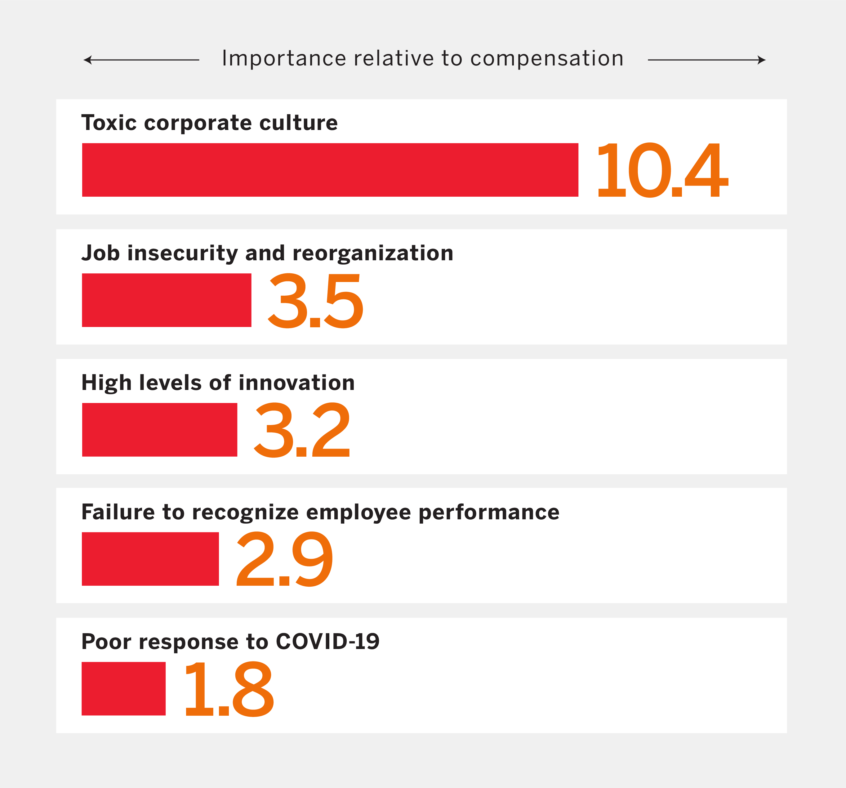
Top Predictors of Attrition During the Great Resignation
Source: MIT Sloan Management Review
Donald Sull, Charles Sull, and Ben Zweig
Notes:
Why does any of this matter?
Aside from the massive issue that our fellow humans – each and all of us, are struggling mightily, there is significant economic and value-based impact on our organizations.
The Great Resignation, or Reshuffle, or Reevaluation – whatever you want to call it – is a real thing, and only picking up steam.
People are voting with their feet and making employment choices that better align with what is most important to them. And leaders need to understand how to effectively deal with this – by doing more than just throwing cash at people.

Slide 11
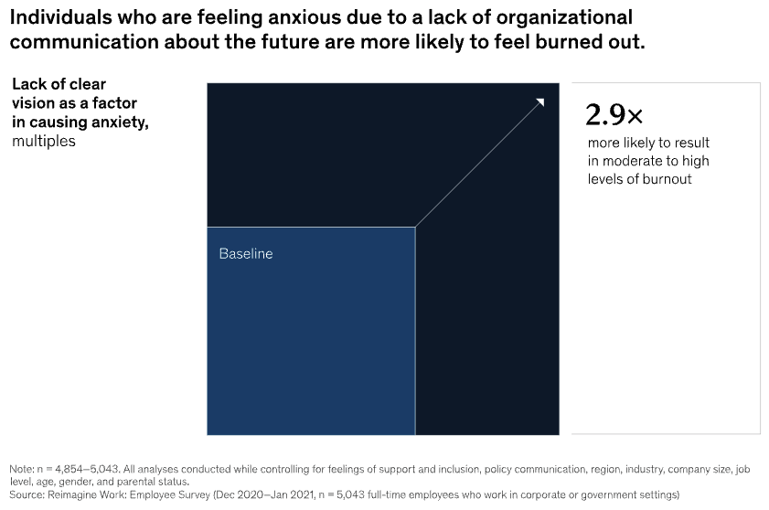

Slide 12

The truth does not change according to our ability to stomach it emotionally
Flannery O'Connor
Notes:
You cannot solve tomorrow's complex challenges with yesterday or even today's thinking and approaches.
Now is not the time for pride or ego, but rather to be open, curious, filled with wonder, and asking "what if?" And "how might we?" questions.
Now is also not the time for leaders to take a "I/we know better than our people" stance. If the last 24 has taught us anything, it is that we actually don’t KNOW what we thought we knew, and what we thought was true and constant maybe isn’t.
Bringing an inclusive approach to problem solving and business growth will foster engagement, learning, and performance in new and even bigger ways. THAT is the path we are on today.

Slide 13
Drivers of stress
Novelty
things that a person hasn’t experienced before
Unpredictability
things that a person had no way of knowing would occur
Threat to ego
when a person’s safety or competency is called into question
Lack of control
when a person’s SENSE of control is minimal or totally absent
INTENSITY OF STRESS
positive | tolerable | toxic
Notes:
I want to help you better understand the causes of stress for people, so we can connect this to the context of your work environment.

Slide 14

Impact of stress
Effects on behaviors
Withdrawal, substance abuse, outbursts, overeating, undereating
Effects on mood
Anxiety, overwhelmed, restless, depression, low energy
Effects at work
disorganized brain, reduced coherence, inhibited creativity, limited flexibility, low effort
Effects on your body
headaches, sleep problems, fatigue, upset stomach, chest pain
Notes:
You now have a better understanding of the causes – here are some of the effects.
This is important for you to get as a leader, so you can observe these things in yourself and your colleagues.
Leaders need to be adept at recognition and addressing these indicators as they become visible.
Keep in mind the criticality of authentic connection – starting with curiosity, empathy, and compassion – it creates space for productive dialogue.

Slide 15


Slide 16

What is the role of leader in creating high performance culture?

Slide 17

Create a Barrier-free Work Environment

Slide 18

I learned that courage was not the absence of fear, but the triumph over it. The brave man is not he who does not feel afraid, but he who conquers that fear.
Nelson Mandela

Slide 19
ENVIRONMENTS, SYSTEMS + RESOURCES
EXPECTATIONS + FEEDBACK
REWARDS, RECOGNITION + CONSEQUENCES
A Systems Issue
EXEMPLARY PERFORMANCE
MOTIVATION + PREFRENCES
CAPACITY + JOB FIT
SKILLS + KNOWLEDGE
Notes:
Here we have the SHIFT high performance system, based upon research and experience with organizational and human performance improvement (Geary Rummler, Thomas Glibert, Joe Harless)–
Each of these 6 arrows/influences has a direct impact on an individual, team, or organization’s ability to perform to consistently perform at high levels – akin to your stars, and to do it with unnecessary friction. Your job is to be an architect who integrates and aligns the work systems.
The top 3 influences are external to the human doing the work – what the organization and leaders do “to” their people. The bottom 3 are what the human brings to the job. In high-performing organizations, all 6 are well aligned and work interdependently in a seamless fashion. – This is hard, partly because there are often different leaders who “own” each of the influences. (Cite an example of those designing compensation/total rewards programs are not the same people setting job expectations or giving direct performance feedback)
The most effective organizations we’ve seen take what they know about the individual (below the midline – skills/knowledge and motivations/preference and capacity/job fit and use the to inform the top lever of “Expectations and Feedback. “ If you’re giving feedback or “coaching” without considering those things and without some questions in mind that first seek insight, you’re reducing your leadership impact.

Slide 20
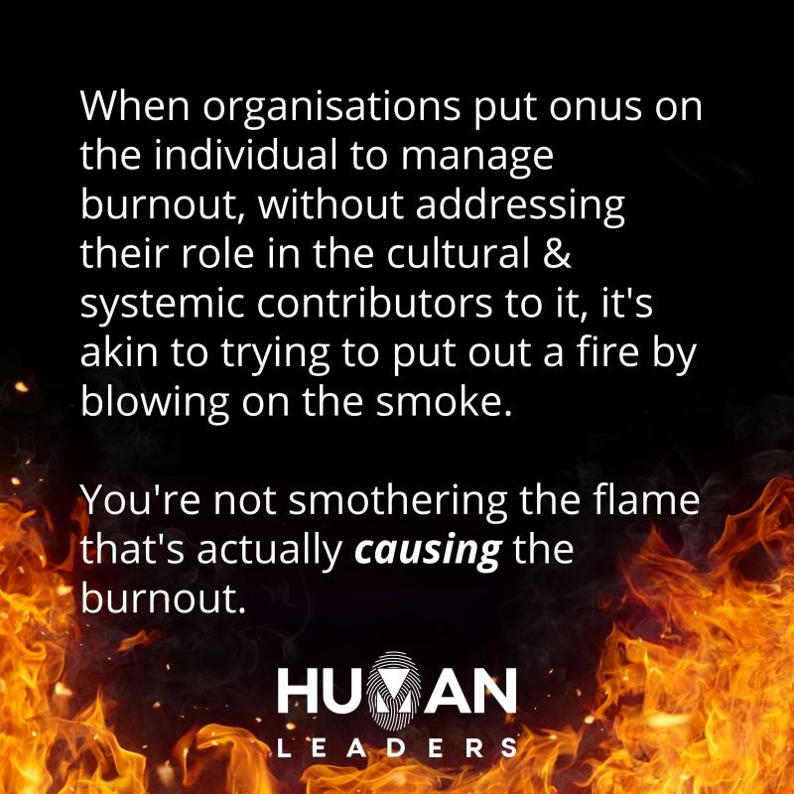
Source: Alexis Zahner,
Human Leaders

Slide 21
Expectations & Feedback
Are clear and measurable performance standards communicated so that people know how well they are expected to perform?
Do incumbents accept the standards as reasonable?
Is feedback provided that describes performance results in a fashion that is consistent with standards and not just observed behavior?
Is feedback timely, frequent, and reinforcing enough to help people remember what they did?
Is feedback essential– limited to a few essential matters of importance and free of vague generalities?
Is it performance-centric – constructive and developmental so that incumbents can learn from it?
ENVIRONMENTS, SYSTEMS + RESOURCES
EXPECTATIONS + FEEDBACK
REWARDS, RECOGNITION + CONSEQUENCES
EXEMPLARY PERFORMANCE
MOTIVATION + PREFRENCES
CAPACITY + JOB FIT
SKILLS + KNOWLEDGE

Slide 22
Environments, Systems & Resources
Job Design
Are there examples of exemplary performance in each of your organization’s critical roles?
Are the role documents and performance support clear enough to mitigate performance issues and errors?
Are the role documents and performance support accurate and up to date?
Are the critical roles designed in alignment with customer requirements and expectations?
Procedures
Are procedures efficient and designed to eliminate unnecessary steps?
Are the procedures designed with the human’s work in mind?
Are the procedures based on sound methods rather than on historical circumstances?
Are good job aids available to avoid unnecessary memorization?
ENVIRONMENTS, SYSTEMS + RESOURCES
EXPECTATIONS + FEEDBACK
REWARDS, RECOGNITION + CONSEQUENCES
EXEMPLARY PERFORMANCE
MOTIVATION + PREFRENCES
CAPACITY + JOB FIT
SKILLS + KNOWLEDGE

Slide 23
Rewards, Recognition & Consequences
Is pay for the job competitive?
Are bonuses or raises given based on, or linked to good performance?
Does consistent, good performance link to career development?
Is good performance free of punishing consequences?
Are meaningful, non-pay incentives given based on results. not behavior?
Are non-pay incentives well scheduled?
Is the environment free of incentives to perform poorly?
Do incumbents clearly understand the consequences of both good and poor performance?
ENVIRONMENTS, SYSTEMS + RESOURCES
EXPECTATIONS + FEEDBACK
REWARDS, RECOGNITION + CONSEQUENCES
EXEMPLARY PERFORMANCE
MOTIVATION + PREFRENCES
CAPACITY + JOB FIT
SKILLS + KNOWLEDGE

Slide 24


Notes:
Shed old habits and outdated processes

Slide 25
Meeting Structures
Schedule between 9 – 5
(could use this approach to have a recurring rhythm to meetings)
Monday | Tuesday | Wednesday | Thursday | Friday
Alignment/focus meetings
LT meetings
Core meetings
Business unit/functional group meeting
Small group recurring meetings
Other recurring important meetings
Ad-hoc meetings
(9 am – 12 pm)
By your design
(12 – 5 pm)
Development conversations
Time to think
Catch up on work
Ad-hoc meetings, non-recurring
Let’s do our best as a team by paying particular attention to recurring or standing meetings

Slide 26

What are some outdated rituals, routines, practices, or processes that you need to shed to address root causes of burnout?
Notes:
Ask what outdated rituals, routines, practices or processes that do you need to shed in order to reduce barriers to engagement and performance – to address root causes of burnout

Slide 27
Understanding
Connection
Empathy

Slide 28
You can’t be too honest. If you learn how to make it safe, you can talk to almost anyone about almost anything.
Notes:
If you are going through the motion without the intention behind it, your employees will know. Your team’s mindset starts with your mindset.

Slide 29


Start with mindset
know where they are
  Ask
  HOW ARE YOU?
Understand their triggers
Internal and external influencers that impact engagement
Learn their challenges
What is getting in their way of performing at higher levels, what is causing friction, what is leading to low levels of productivity
Explore their motivators
Intrinsic – what moves the employee into action
Extrinsic – ways you can help the employee focus on what matters
Notes:
1. Let the employee go first - i.e. before I start with my headline, interested to get your perspective. What are the top 1-2 areas in which you feel you shined, and 1-2 biggest learnings. Then provide your perspective - "when I thought about this…"- Communicates value because you took the time to prepare
2. Make it real – be authentic
3. Connect the dots - connect themes and how they impact future growth
Move it forward - be actionable on what these themes could mean for next year
4. Cement the learning - as we close the conversation, what is it that you now feel that you KNOW, FEEL, and what are you going to DO
Respect that this could be an ongoing discussion - make sure there is some action, even if it means scheduling a follow up call

Slide 30
Make it safe
I’m committed to making us better.
What do you find most valuable/helpful
in our interactions?
How can I be a better partner?
Go first
Express gratitude by reinforcing what you value
Be present by making eye contact and being mindful of your energy
Listen
Ask good questions
Be vulnerable and transparent

Slide 31
Stay Interviews
What do you look forward to most when you come to work every day?
What do you dread about work every day?
When was the last time you thought about leaving the company?
What situation made you think of leaving?
Would you recommend our company to job-seeking friends? Why (not)?
What would tempt you to leave the company?
What is the best part of your job?
What part of your job would you cut out straight away if you could?
Which of your talents are you not using in your current role?
Source: Neelie Verlinden, Co-founder of the Academy to Innovate HR

Slide 32


Slide 33

The attempt to escape from pain, is what creates more pain.
Gabor Mate

Slide 34
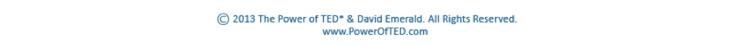
The Drama Triangle
RESCUER
Poor You
Pain Reliever
Fears Not Being Needed
PERSECUTOR
The Problem Dominates Blames Tears Down
VICTIM
Poor Me
Feels Powerless
Dream Lost or Denied

Slide 35
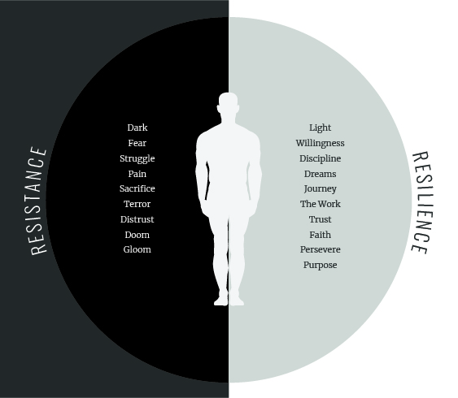
Time to Thrive
Light and Dark

Slide 36
You gain strength, courage, and confidence by every experience in which you really stop to look fear in the face. You must do the thing which you think you cannot do.
Eleanor Roosevelt
Notes:
The role of the leader – now, and always is to create a barrier-free work environment.
We need you to consider – then take action on what you can do to understand what barriers to excellence exist, and then to eliminate them. Only then will you be able to truly attract, grow, and retain the best talent possible.

Slide 37




Prioritize fundamental well-being
Emotional
Gratitude practice
Limited time on screens, media, and devices
Physical
Exercise
Movement
Supplements
Mental
Sleep
Routines
Coaching
Spiritual
Meditation
Breathing
Reflection

Slide 38
Routines
What is your ideal day?
Morning
Evening
6:00am – Up & Gratitude
6:15am – Pups and workout
7:45am – Calibrate with JoAnn
8:00am – Value Added Touch Points
9:00am – Team Connections
5:30pm – Done Working and reentry
6:30pm – Dinner/Connection
7:30pm – Chill/Hydrate/Decompress
9:00pm – Last Walk and Talk
10:00pm – Lights out

Slide 39
A Recipe for Success
TYPICAL APPROACH TO PERFORMANCE
PEOPLE ARE EQUIPPED
TO PERFORM TASK
THAT PRODUCE OUTCOMES
THAT ACHIEVE GOALS
SHIFT APPROACH TO PERFORMANCE
DETERMINE INFLUENCES
ANALYZE TASK
DETERMINE OUTPUTS OF VALUE
DEFINE SUCCESS

Slide 40
Resources
21 Best Stay Interview Questions
https://www.aihr.com/blog/stay-interview-questions/
HBR article, Burnout Is About Your Workplace, Not Your People:
https://hbr.org/2019/12/burnout-is-about-your-workplace-not-your-people
SHIFT Blog
https://www.shiftthework.com/blog
THRIVE Accelerators
https://thrive.shiftthework.com/accelerators

Slide 41

Now what?
Interested in a free 1:1 burnout prevention strategy session? Email us at team@shiftthework.com

Slide 42

Good results put you out of business. Great results keep you in the middle of the pack. Organizations that THRIVE set new standards for business.
Andrew Freedman - Thrive

Slide 43
